Slide 1
Praktikum: Cloud Data Bases Group 7
Aly Kamel, Iremnur Kidil, Ricardo Kraft
28.01.2020
Notes:
13s

Slide 2
Overview
Motivation
Use case scenario
Implementation
Performance Tests
Conclusion

Slide 3

I. Motivation
Redis – Pub/Sub
TOPIC
Publisher
(Sender)
Subscribe
Subscriber N
(Receiver)
Publish
Receive
Notes:
subscribers are idle, just supposed to wait and receive

Slide 4
II. Motivation
Group chat
CHAT ROOM
Client N
Sends
Sends
Client N
Receives
Receives
4
Notes:
no difference between publshers and subscribers

Slide 5
II. Motivation
1 : N
vs.
N : N
Notes:
compared to pubsub we need a many-to-many communication on the same object

Slide 6


II. Use case scenario
Cookie Factory
Notes:
lets say fr example we have a cookie factory with this specific model

Slide 7

Cookie Factory
Global-Chat
NEW YORK
MUNICH
NYC MANAGER
MUC MANAGER
NYC-Chat
MUC-Chat
Brooklyn
Queens
Bronx
Garching
Pasing
Laim
Notes:
Kvs store to save orders for delivery,
Exchange information regarding orders
Different communication channels for managers vs employees

Slide 8




II. Use case scenario
Demands of the client
Unique usernames
Database access while chatting
Public chatrooms
Closed-off chatrooms
8
Notes:
knowledge of who you are talking to
modify orders
ability to share info with all coworkers or limiited to people with special access rights

Slide 9

II. Use case scenario
Our solution
Notes:
now we talk about how we tackled these demands

Slide 10
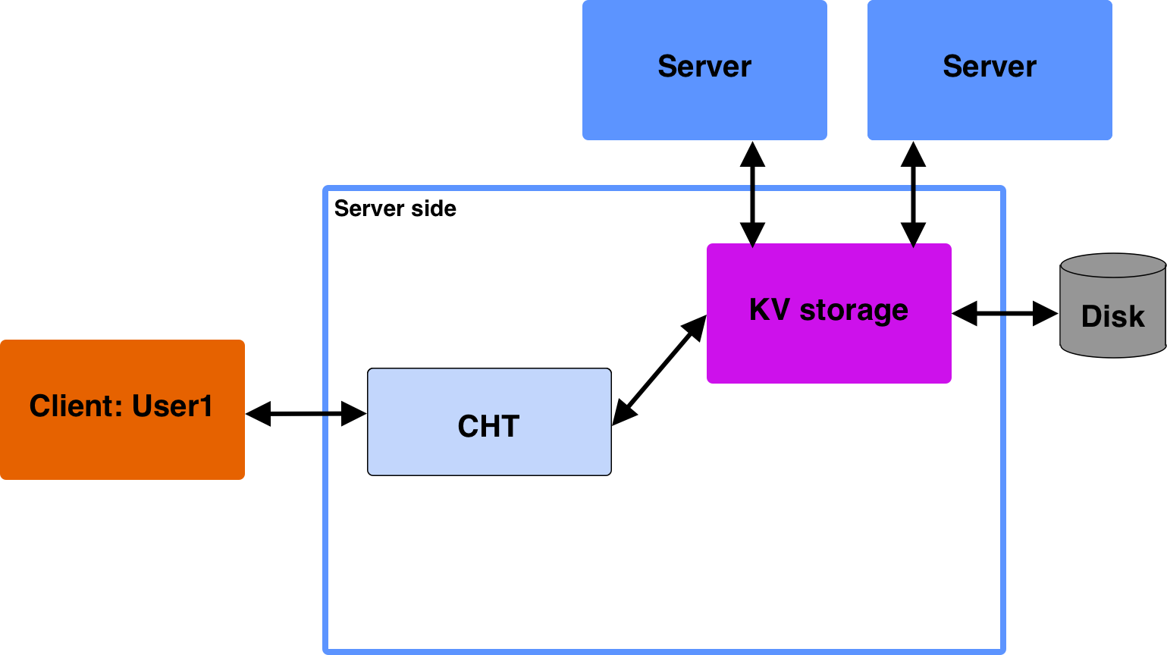
III. Implementation
System design

Slide 11
Notes:
So this is our old implementation from milestone 4.
Client sends request to CHT, CHT forwards request to KV storage system, KV storage puts/gets/deletes value from disk/cache and returns it back to client
If replication is on, the kv storing system also sends the information to two other servers (the replicas)

Slide 12
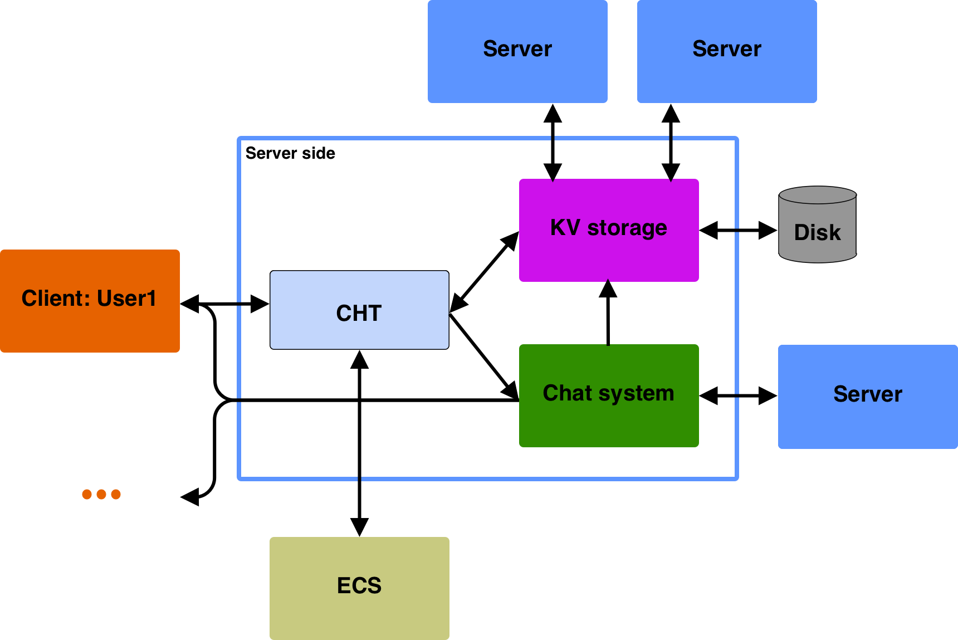
Notes:
Now this is our new system
After connection user sends name to cht who checks with ecs to make sure its globally unique and not taken
Client requests could be forwarded to kvstorage or chat system depending on input
Chat system could communicate with server to perform operations (more on that later), sends messages to user1 and other clients in same chatroom
Chat system stores messages in kvstorage

Slide 13
Notes:
Client -> CHT -> CM -> forward to connected chatroom -> chatbot -> client side -> connect to kv server and do operation
Server -> bot -> chatroom -> all connected users
Client -> CHT -> CM -> Client: when trying to join chatroom, enter password, etc..

Slide 14






III. Implementation
Our steps
Create and join public chatrooms
Make chatrooms globally unique
Write in the chat
Save chat history
Send notifications of joining and leaving users
Have a unique username

Slide 15

III. Implementation
Availability problem
Connecting to a chatroom uses the one and only socket of the client.
How do we access the database while being in a chatroom?
Increase the socket size?
Exit the chatroom and rejoin quickly?
What do we do then?
No, that would increase network traffic.
No, we could miss messages.
The ChatBot.

Slide 16
III. Implementation
ChatBot
GarchBoss: Hey! I want to update my order, because I ran out of cookies.
GarchBoss: PUT garchingOrder “300 chocolate chip cookies, 200 apple cinnamon cookies, 500 white chocolate cookies“
GarchBoss: SUCCESS
MucManager: GET{garchingOrder}
MucManager: 300 chocolate chip cookies, 200 apple cinnamon cookies, 500 white chocolate cookies
MucManager: Only problem, I have just 400 white chocolate cookies.
Notes:
Bot used to access database without leaving room, replaces gets in messages

Slide 17
III. Implementation
Message handling
Key-value server
ChatManager
ChatRoom
ChatBot
User1

Slide 18
Key-value server
User1: I have GET{n} cookies
n
5
ChatManager
User1: I have GET{n} cookies
ChatRoom
ChatBot
I have GET{n} cookies
User1: I have 5 cookies
User1: I have 5 cookies
User1

Slide 19
III. Implementation
Private chatrooms
Password protected chatrooms for e.g. filtering the regions
NEW YORK
NYC MANAGER
NYC-Chat
Brooklyn
Queens
Bronx

Slide 20
III. Implementation
Additional Commands
ACTIVE
Returns a list of all users in the chatroom.
WSP <user1>,<user2>,…,<userN>
Sends a whisper to provided clients.
HELP
Displays all possible commands.
QUIT
Disconnects from the chatroom.
Notes:
Explain active, wsp (only possible for users in the same chatroom)
Skim over help, quit
(if you don’t like this design change it back)

Slide 21


IV. Performance evaluaiton
Constants
320 key-value pairs from the EnronSet
Cache replacement strategy: LRU
Cache size: 16
Key order randomized
Each test ran 5 times
Notes:
First we take a look at the constants that we use in all of our tests. We test our system with 320 key-value pairs from the EnronSet. We first execute a put request on all keys, then get requests and then delete requests. We use the cache replacement strategy Least Recently Used and have a cache size of 16, which represents 5% of the 320 key-value pairs we test our system with. We randomize the key order between each different operation, so finding a value in the cache is based purely on luck.
To obtain a data point in our graphs we ran each test 5 times and took the average of the results.

Slide 22
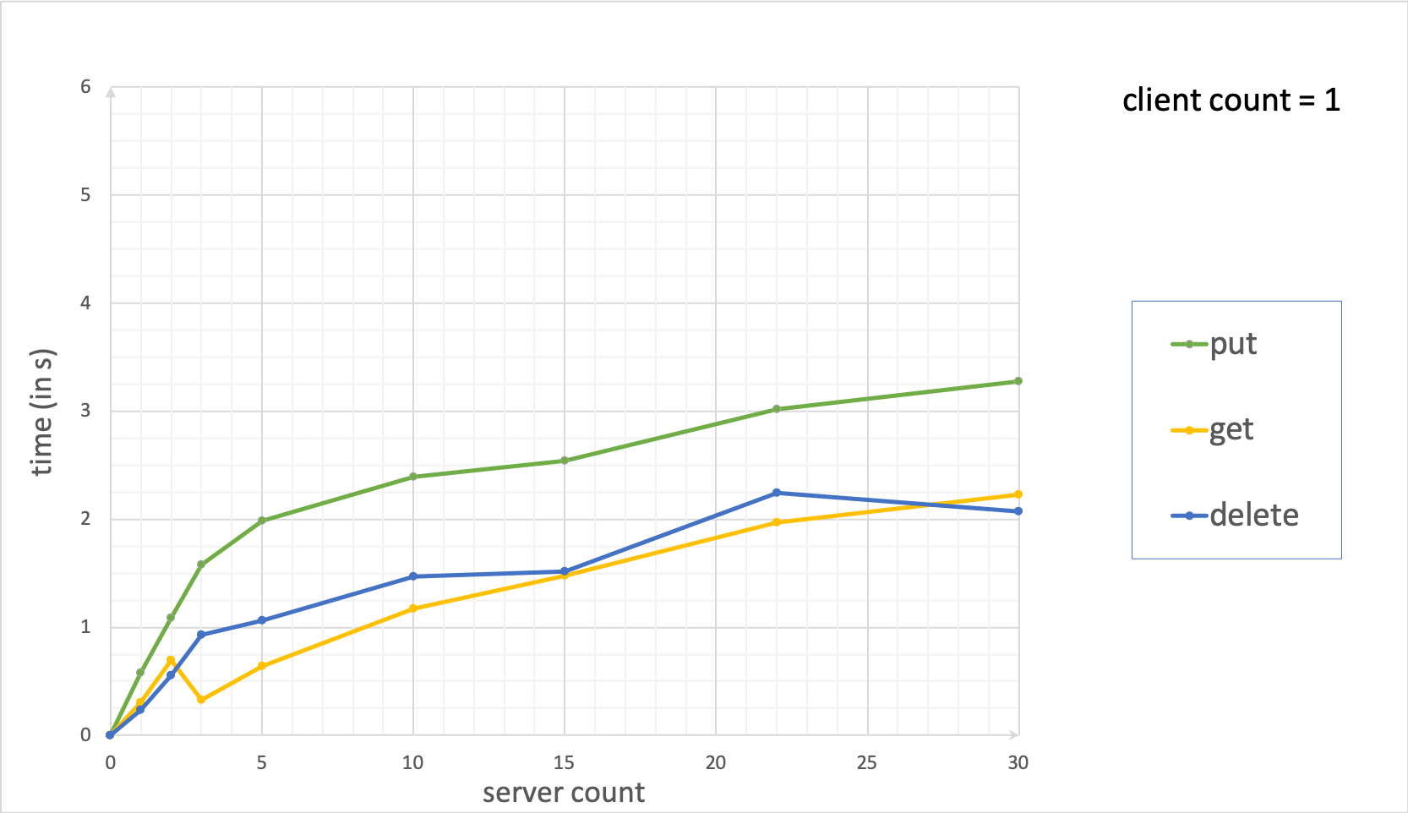
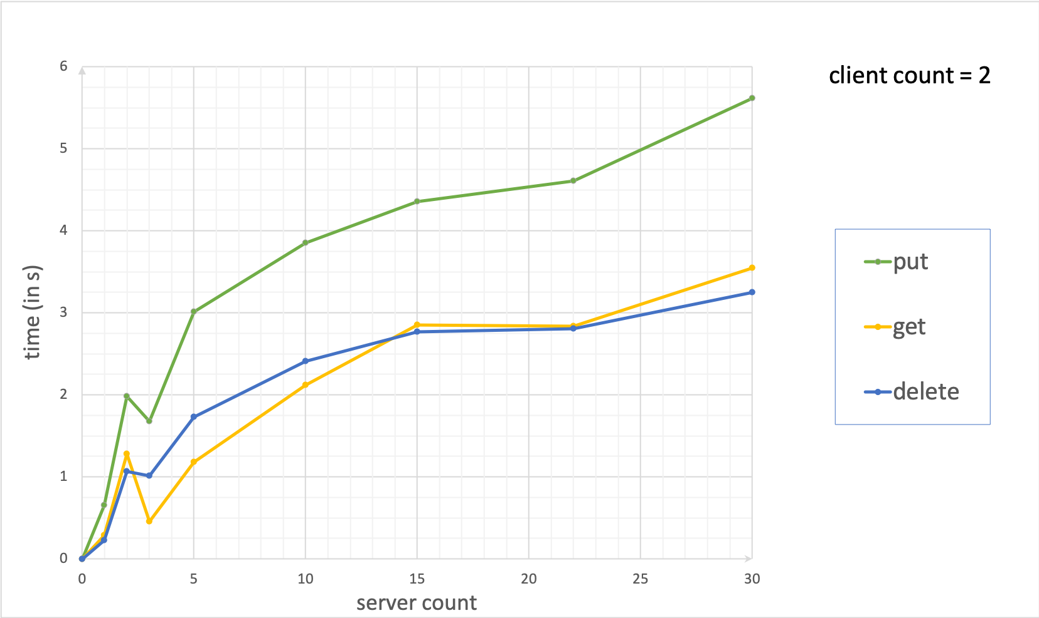
IV. Performance evaluaiton
Varying server count
Notes:
First we try varying the server count and see how the response time changes.

Slide 23
Notes:
On the x-axis we have the server count and on the y-axis the time the operation on 320 keys took in seconds. Currently just one client is executing commands on the server. As you can see, puts are much slower than gets and deletes, because puts need to access the disk for each operation and write into a file. Delete just needs to find the file and delete while gets might not even need to read a file and might just obtain the value from the cache. With 3 servers online, replication is started which means now get operations are faster, since all 3 servers are responsible for the value and the client does not need to reconnect unlike with a delete or put. When we increase the server count gets start to get slower. At 30 servers, only 3 out of 30 which is 10% of the servers are responsible for each given key, so there is a 90% chance that the client needs to reconnect with every key.

Slide 24
IV. Performance evaluaiton
Varying server count

Slide 25
Notes:
Here we can see the same graph but for two clients. Obviously the operations take more time now, since the client amount is doubled and the requests are doubled. However the response time of the servers does not double.

Slide 26
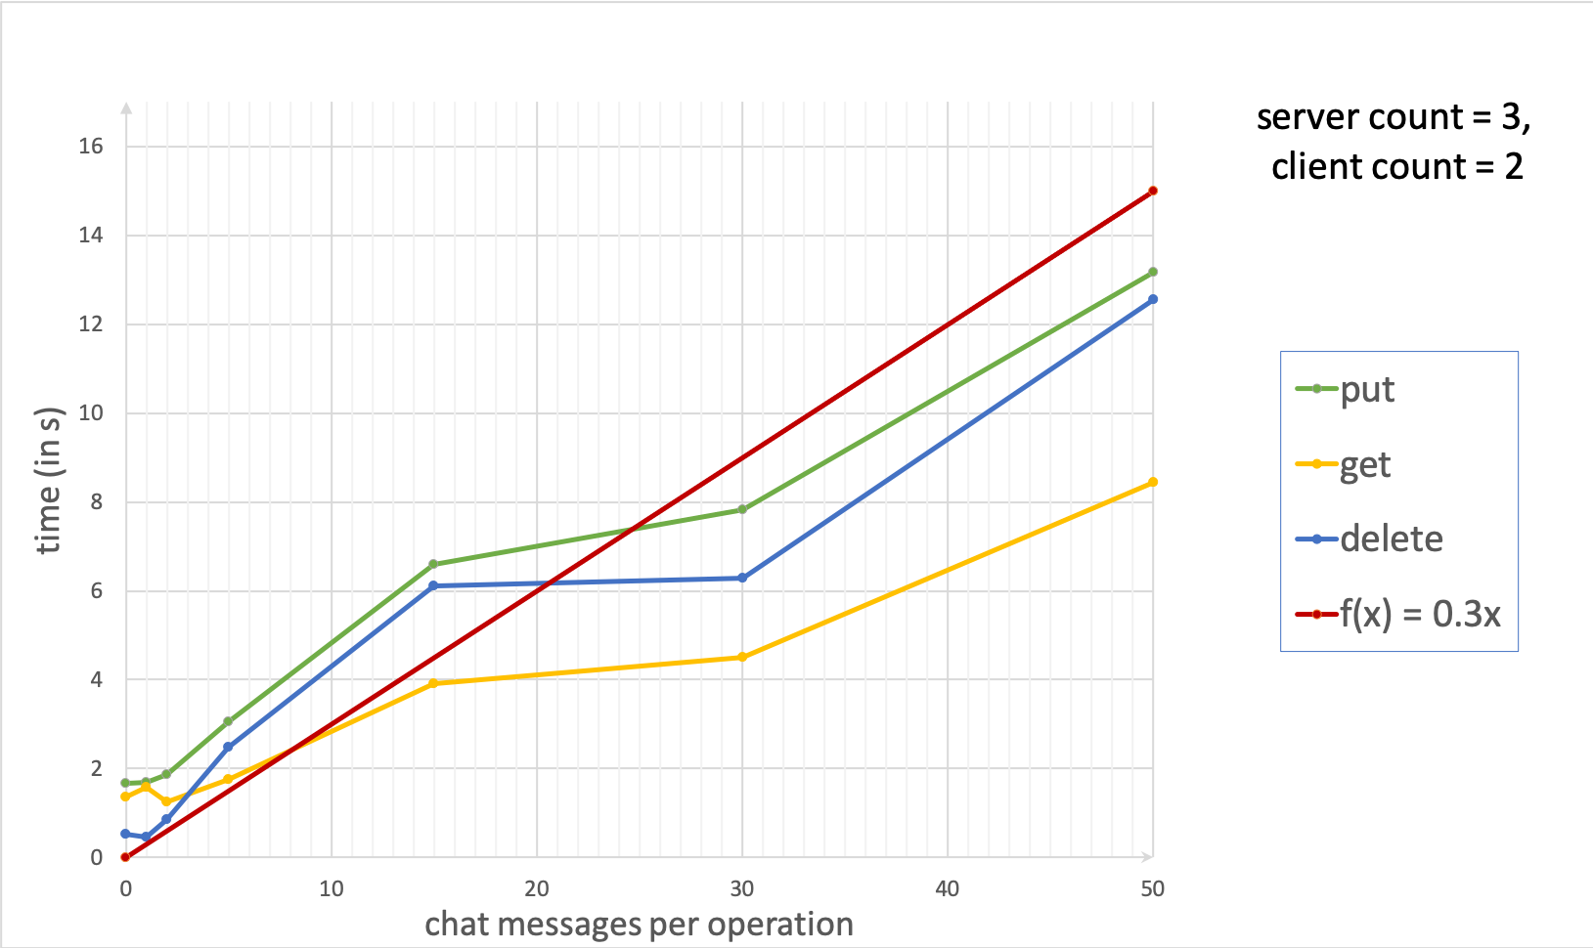
IV. Performance evaluaiton
Testing chat functionality
Notes:
Now we come to testing our chat implementation. Here, instead of doing normal database operations, every operation is done inside a chatroom. As previously explained, a bot is responsible to execute these commands. We use two clients and 3 servers for this test and both clients are in the same chatroom.

Slide 27
Notes:
On the y-axis we still measure time in seconds but on the x-axis we measure chat messages that get executed between each operation. So after every database operation, we send x amount of normal chat messages in the chatroom. Doing operations in a room is slower than doing it outside of a room, because an extra connection to the bot is required and the bot does operations for all chat users. With few messages sent, the extra time required compared to the normal database operations seems unnecessary. However, as the chat messages increase, we see that the time does not grow proportionally. Our response times roughly follow the path of the function 0.3x, which means for every additional chat message per operation (which equals to 320*2=640 additional messages overall), the system is slower by just 300 miliseconds. That means in one additional second we can send an extra ..

Slide 28
V. Conclusion
Pros
Light-weighted communication
Acces to database while chatting
Reduced network traffic
Cons
Chatroom limits
ChatBot is bottleneck
Notes:
Decrease load on 1 server -> limit chatrooms/clients
Increase availability for kvs during chat -> chatbot bottleneck
Recommendation for lightweight chatting

Slide 29
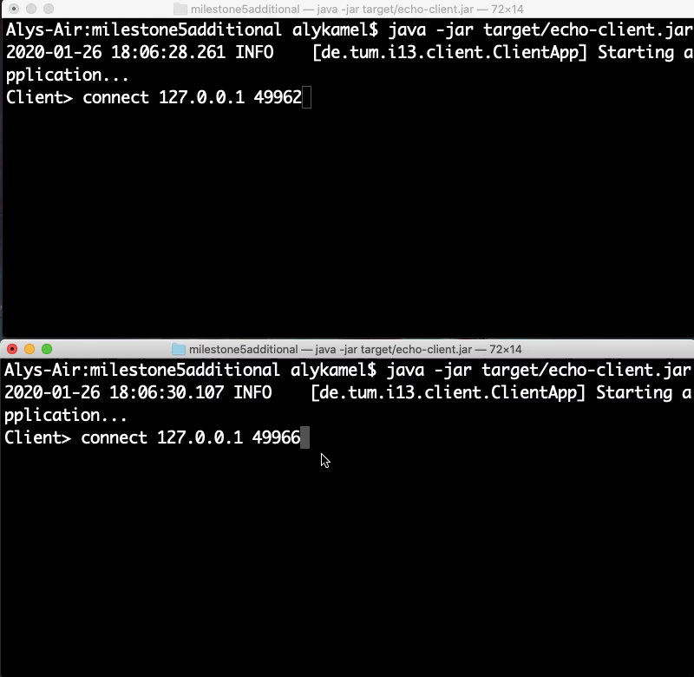
VI. Demonstration

Slide 30
THANK YOU FOR YOUR ATTENTION!

